Slide 1
Home
Account
Canteens
Cart
Feedback
Login/Logout
Register
Food Options
Payment

Slide 2
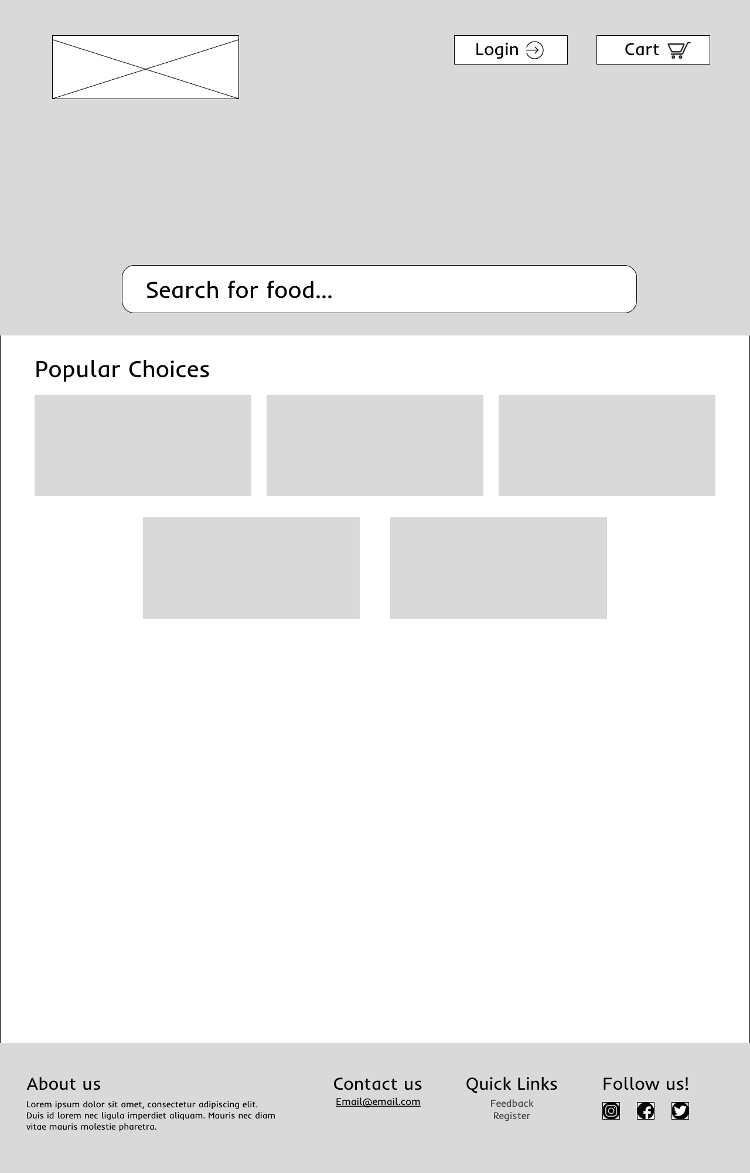
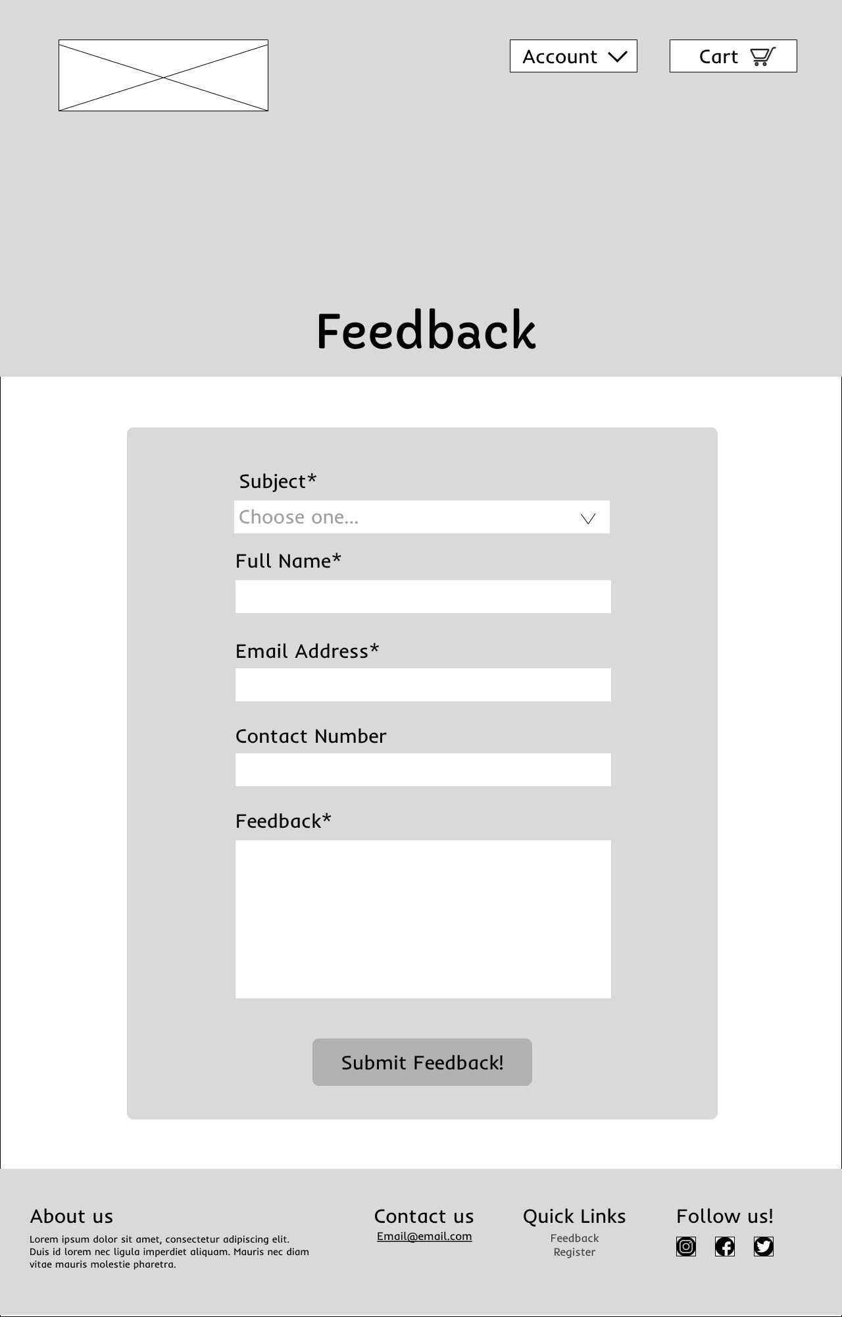
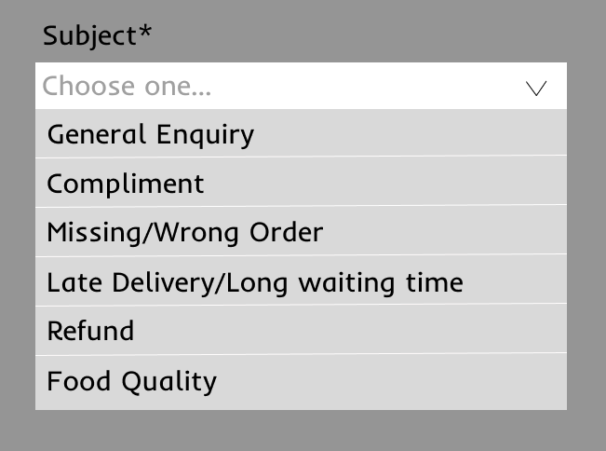
Scenario 1: User filing feedback
Drop down for subjects
Link to feedback form
Invalid submission
Home Page
Feedback Page
Successful submission will prompt user with success message

Slide 3
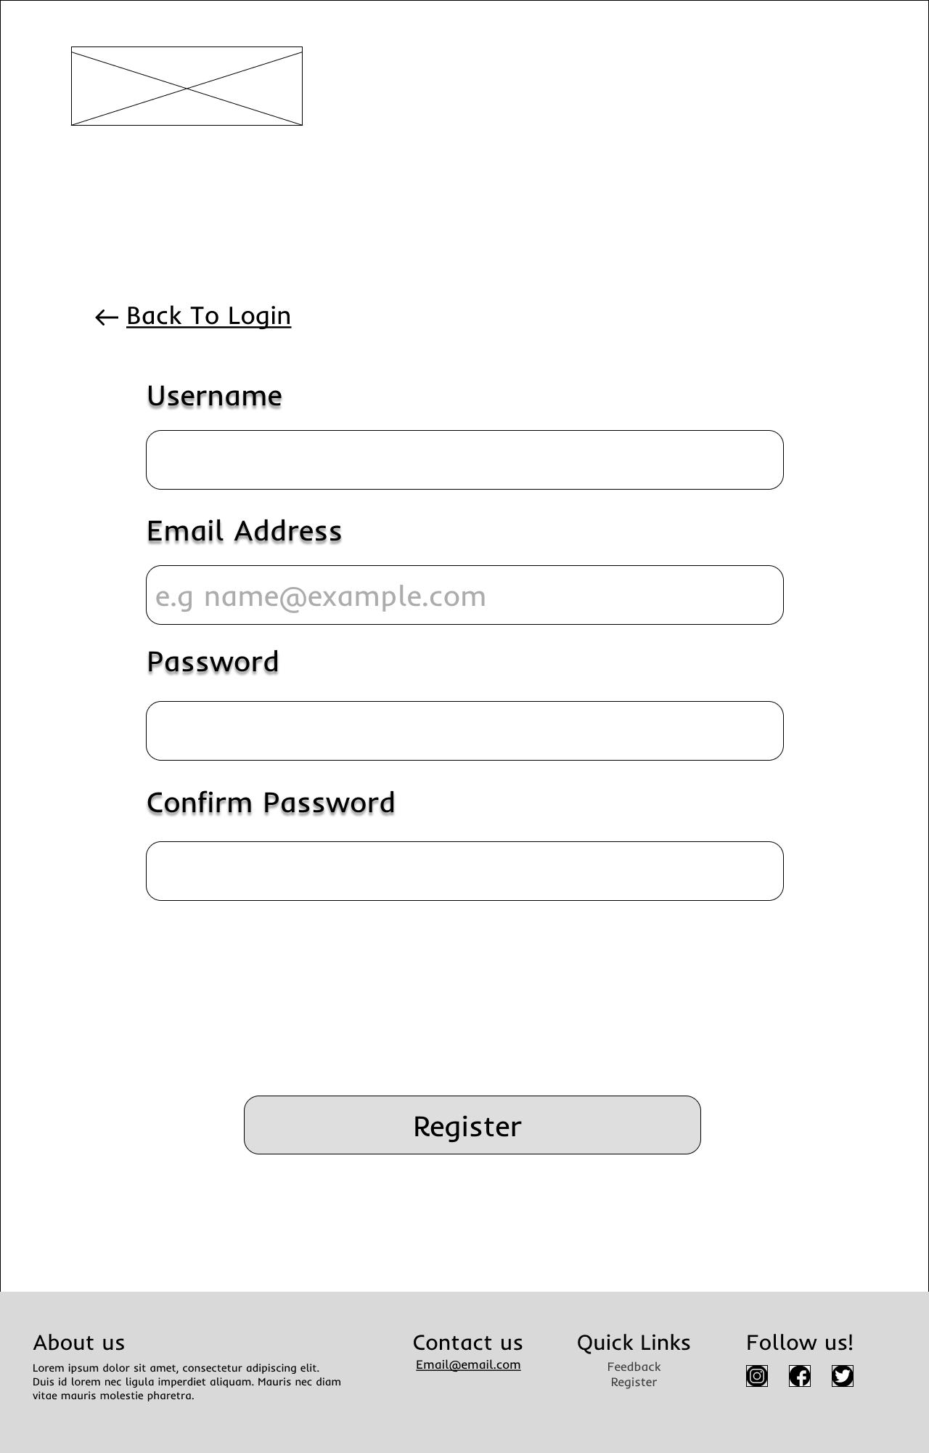
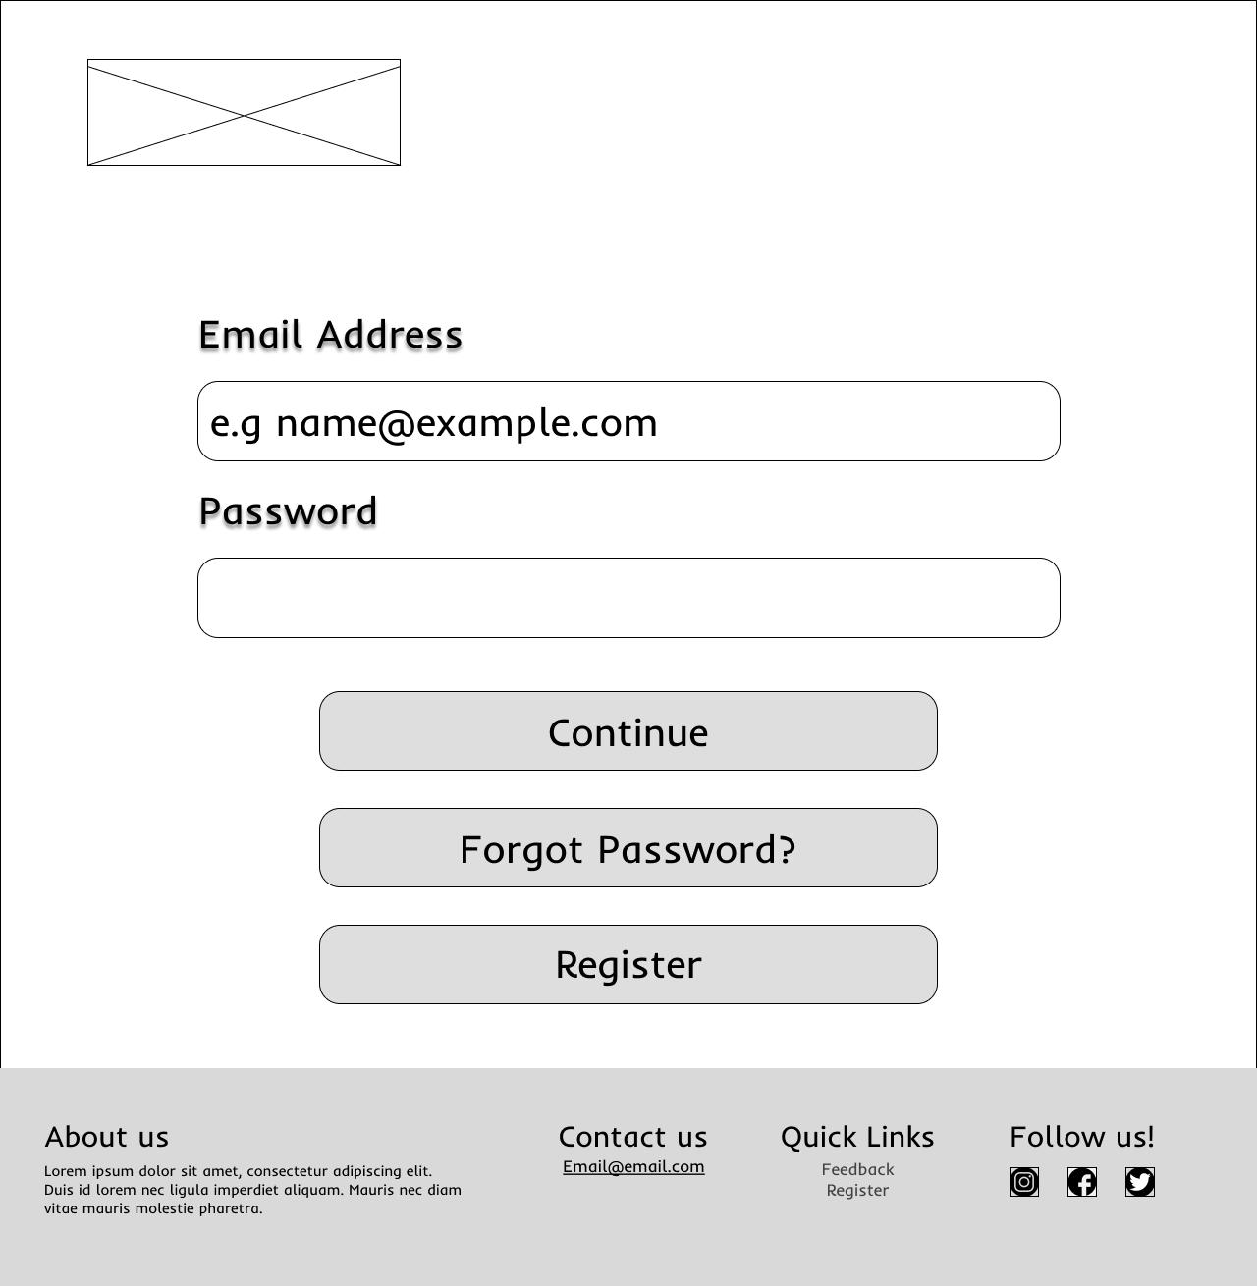
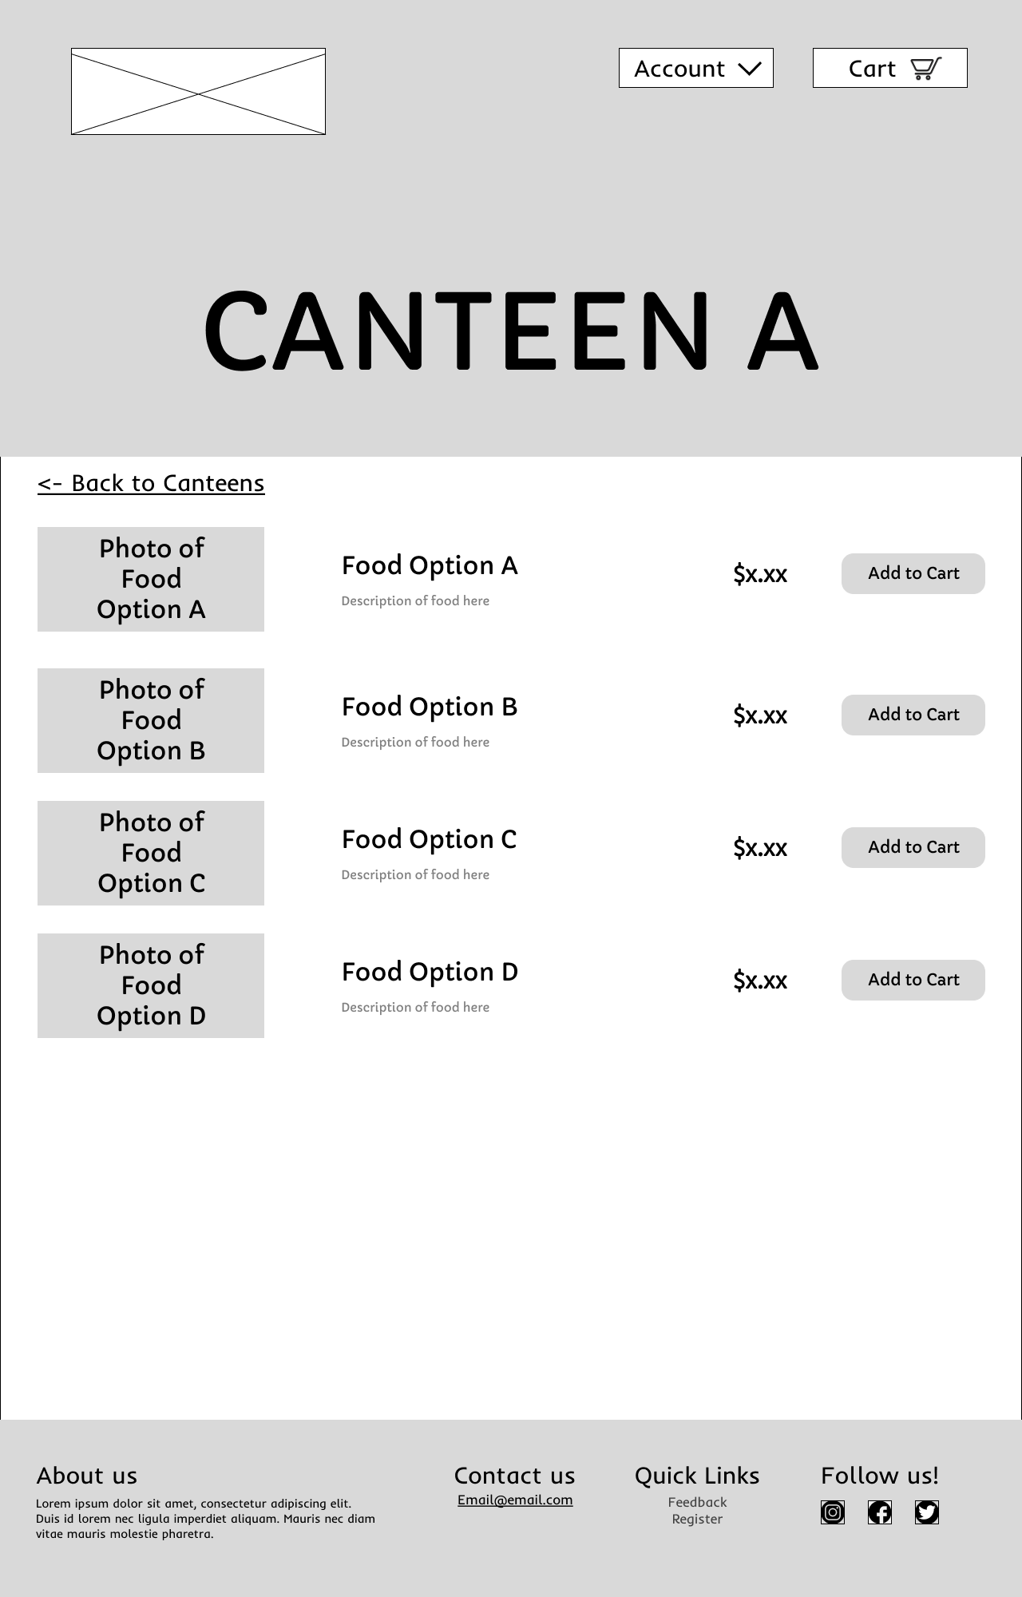
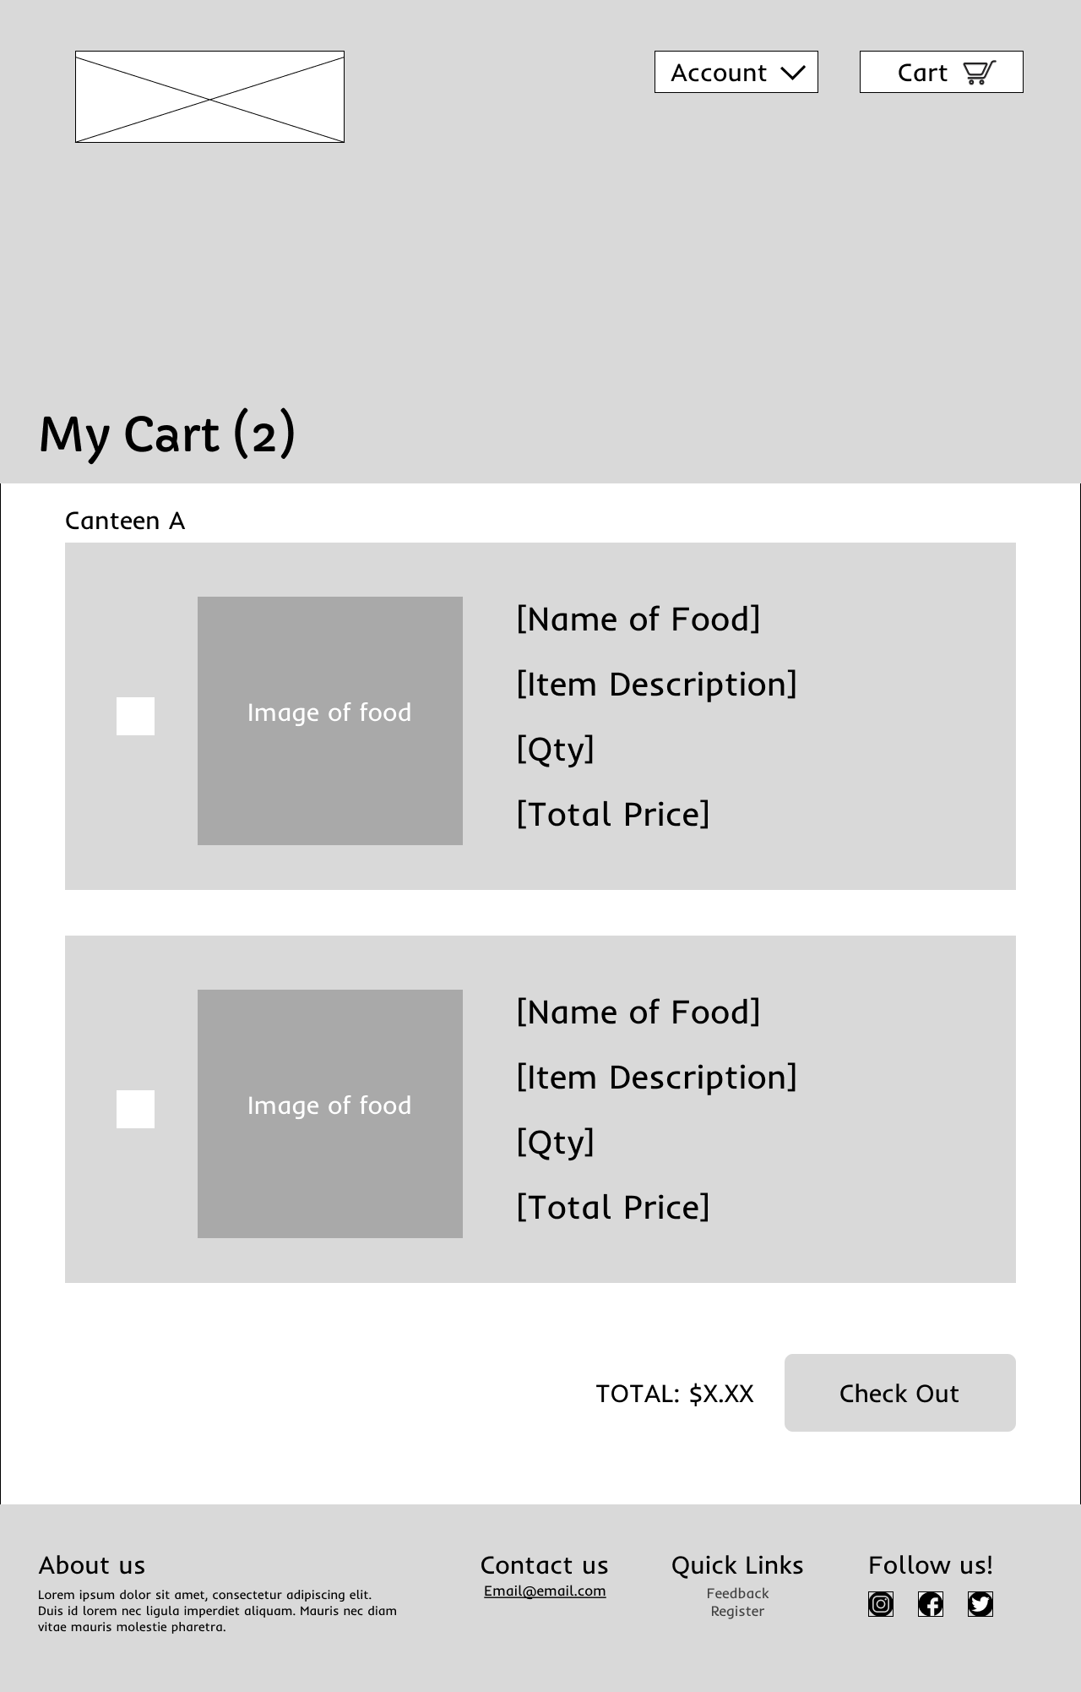
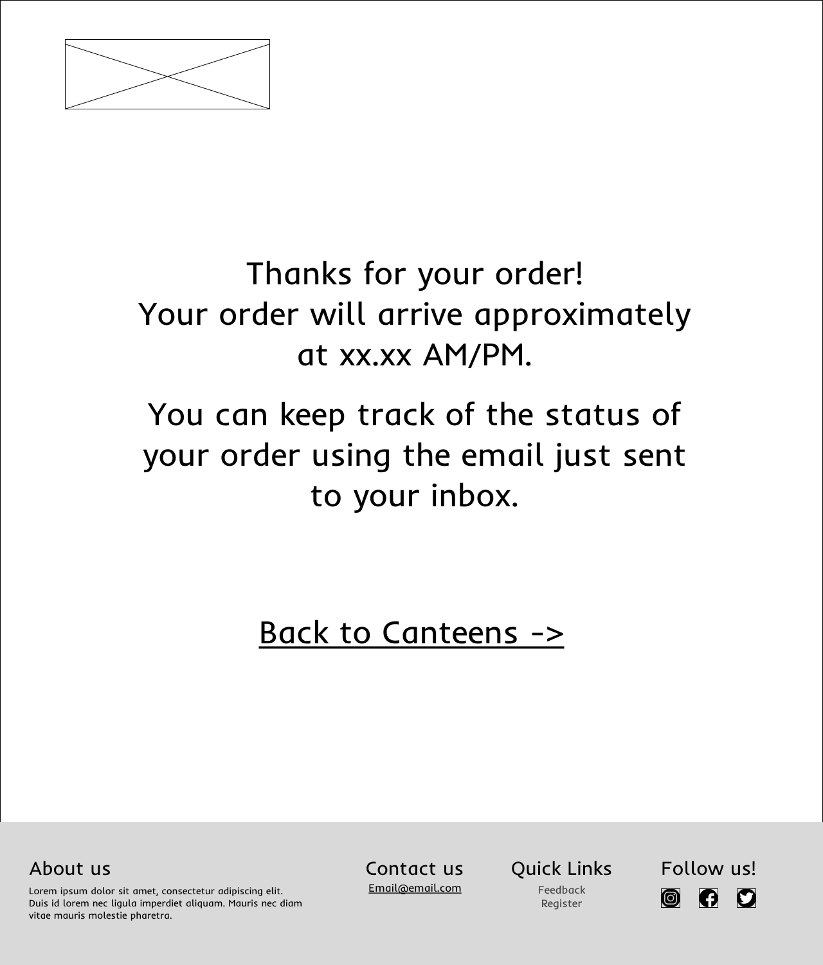
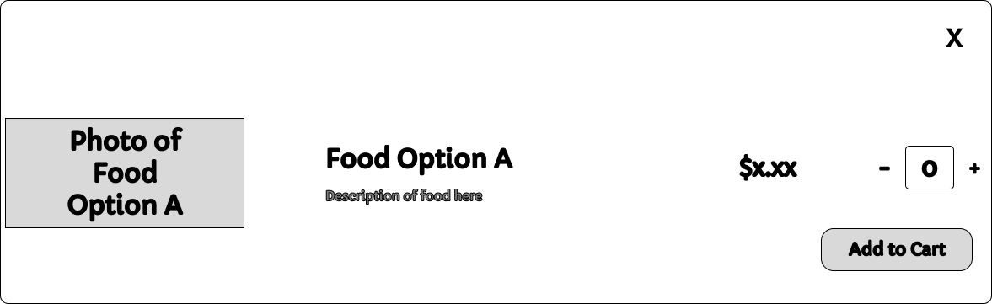
Scenario 2: New user finding popular choices for food
Failed registration returns to same page
Users need to login before selection can be made
User registration
Login Page
Register Page
Successful registration shows popular food choice pop up
Home Page
Viewing Cart
Checkout and Payment
After selection of number of product and add to cart
Food Options Page
Post Payment Page
Cart Page

Slide 4
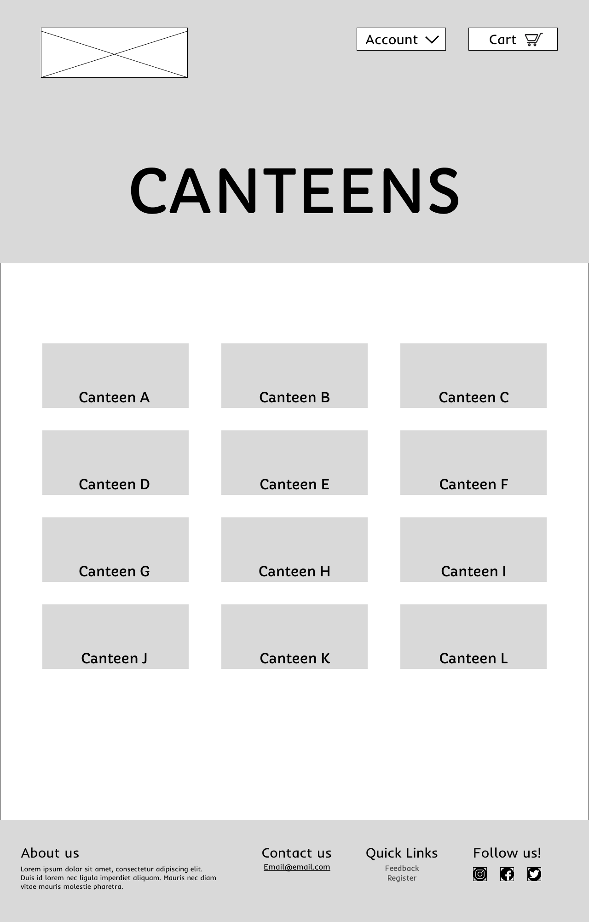
Scenario 3: Existing user ordering food
Failed login will prompt user with “try again” prompt
User login
Successful login
Login Page
Viewing Cart
User select Food Option A
User select Canteen A
Home Page
Canteens Page
After selection of number of product and add to cart
Food Options Page
Checkout and Payment
Post Payment Page
Cart Page

Slide 5
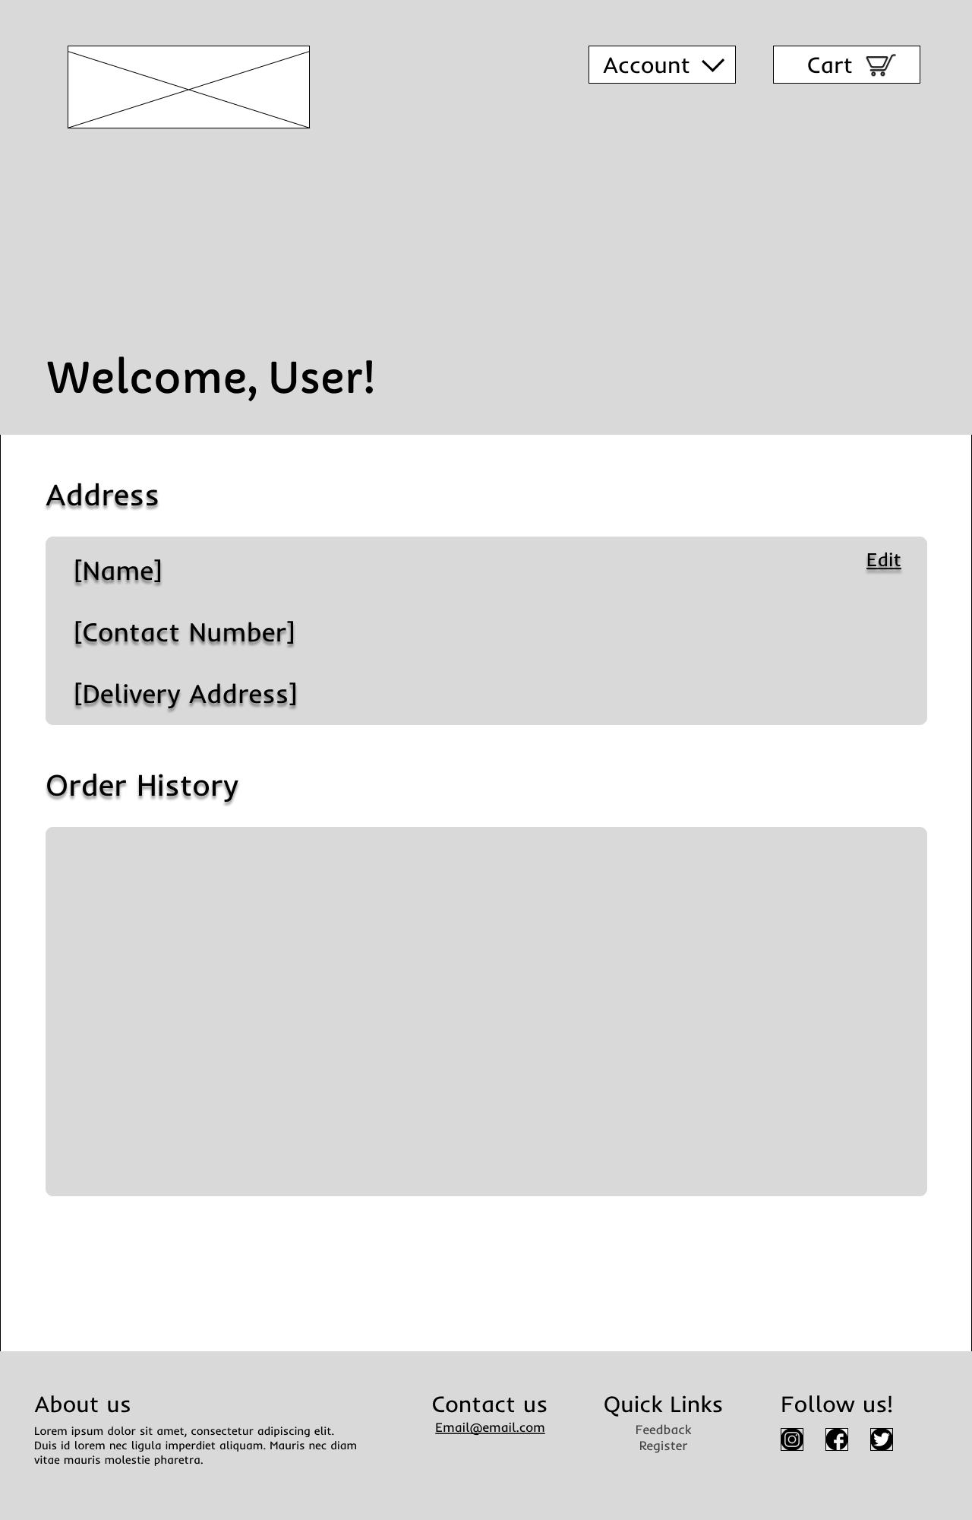
Scenario 4: Existing user viewing account details
Failed registration returns to same page
Users need to login before selection can be made
User registration
Login Page
Home Page
Successful login
User checking account details
Canteens Page
Accounts Page

Slide 11
